Slide 1


English Lessons: Reflection Time
L.O.
To be able to reflect on my own ability in English lessons
Self-Assessment Letter

Slide 2

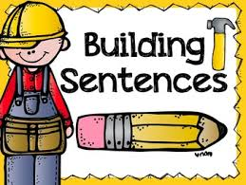





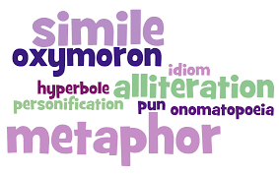

L.O.
To be able to reflect on my own ability in English lessons

Slide 3
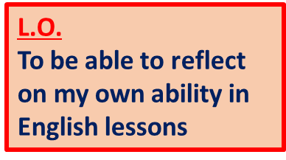
Reflecting upon your English last term:
You have been at Bourne for a term now. Hopefully you haven’t forgotten some of the valuable English skills you learnt before Christmas and New Year.
This is a great time to think over what you have learnt and make some new year resolutions for this new decade.
English lessons cover different skill areas within reading, writing and speaking.
Which ones do you think you have mastered, and which do you still find difficult?
Starter task: Make a list in 2 columns of what you feel you can/cannot do!

Slide 4
Here are some areas you might consider:
Spelling
Punctuation at the end of sentences
Sentence variety
Using commas within sentences
Using paragraphs
Punctuating speech properly
Using apostrophes
Using interesting vocabulary
Using metaphors/similes
Varying connectives in sentences
Consistency with tenses
Common homophone confusion: to/too/two
Spelling irregular plurals correctly: storys x
Good tidy presentation
Legible handwriting

Slide 5

Main Task: Writing a letter to me
I want you to write a letter addressed to me, telling me about how English has gone for you so far this school year.
I want you to introduce yourself.
I then want you to explain what you have covered so far this school year, from September.
I want you to be honest and say what you can do well and what you can’t do as well!
I also want you to tell me what you need most help with.
Lastly, I want you to consider where you want to be with your English by the end of the year.

Slide 6
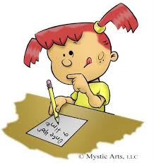
Main Task: Here is a template for you: Dear Mr Old,
My name is …….and I’m……
So far in English this year I have…
The activity I have enjoyed most is…
I find the most challenging thing about English is…
I definitely need help with…
My presentation/handwriting is…
I would say that my spelling is…
My choice of words…
By the end of the year, I hope…
All in all, I think…
Yours sincerely, …

Slide 7
Here is one pupil’s example
Dear (teacher’s name),
My name is Jimmy Clift and I’ve been in 8W since September. You can’t miss me in the class. I’m the one with carrot hair and glasses.
So far this year in English, I have studied Shakespeare and read ‘A Midsummer Night’s Dream.’ This was quite challenging but the Mechanicals made me laugh. I read Bottom’s part.
The thing I’ve enjoyed most about English lessons is when we got to act out parts of the play. This is because I speak better than I write. I find writing most challenging because I don’t write in enough detail and I run out of things to say. I especially need help with punctuation. I forget when I need to use a full stop or a comma.
By the end of the year, I want to make sure I gain more confidence with using better words including trying to use fewer ANDs and instead use better connectives.
Yours sincerely, Jimmy

